Slide 1


Decision Tree Classifier
By: Sidhidatri Nayak
CDAC,NOIDA,India

Slide 2
Notice regarding the usage of images:
This document contains images obtained by routine Google
Images searches. Some of these images may perhaps be under
copyright. They are included here for educational and
noncommercial purposes and are considered to be covered by
the doctrine of Fair Use. In any event they are easily available
from Google Images.

Slide 3

Decision Tree Classifier
A decision tree is a flowchart-like tree structure.
An internal node represents feature(or attribute)
the branch represents a decision rule
Each leaf node represents the outcome.
The topmost node in a decision tree is known as the root node.
It learns to partition based on the attribute value.
It partitions the tree in recursively manner call recursive partitioning.
This flowchart-like structure helps you in decision making.
It's visualization like a flowchart diagram which easily mimics the human level thinking.
That is why decision trees are easy to understand and interpret.

Slide 4
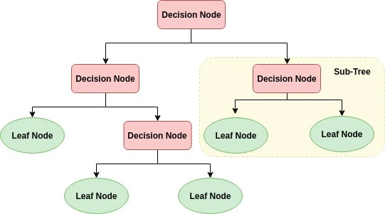
Decision tree

Slide 5
How does the Decision Tree algorithm work?
Select the best attribute using Attribute Selection Measures(ASM) to split the records.
Make that attribute a decision node and breaks the dataset into smaller subsets.
Starts tree building by repeating this process recursively for each child until one of the condition will match:
All the tuples belong to the same attribute value.
There are no more remaining attributes.
There are no more instances.

Slide 6
Decision Tree Classifier
Greedy strategy: Split the records based on an attribute test that optimizes certain criterion.
Issues
Determine how to split the records
How to specify the attribute test condition?
How to determine the best split?
Determine when to stop splitting
How to Specify Test Condition?
Depends on attribute types
Nominal
Ordinal
Continuous
Depends on number of ways to split
2-way split
Multi-way split

Slide 7
Decision Tree Classifier
Splitting based on Nominal Attributes
Multi-way split: Use as many partitions as distinct values.
Binary split: Divides values into two subsets.
Splitting based on Ordinal Attributes
Multi-way split: Use as many partitions as distinct values.
Binary split: Divides values into two subsets
Family
CarType
Luxury
Sports
Size
Small
Large
{Family, Luxury}
CarType
Medium
{Sports, Luxury}
CarType
OR
{Sports}
{Family}
{Small, Medium}
Size
OR
{Medium, Large}
Size
{Large}
{Small}

Slide 8
Decision Tree Induction Techniques
Different algorithms have been proposed to take a good control over
Choosing the best attribute to be splitted, and
Splitting criteria
Several algorithms have been proposed for the above tasks. In this lecture, we shall limit our discussions into three important of them
ID3
CART

Slide 9
Algorithm ID3
In ID3, entropy is used to measure how informative a node is.
ID3 algorithm defines a measurement of a splitting called Information Gain to determine the goodness of a split.
The attribute with the largest value of information gain is chosen as the splitting attribute and
it partitions into a number of smaller training sets based on the distinct values of attribute under split.

Slide 10
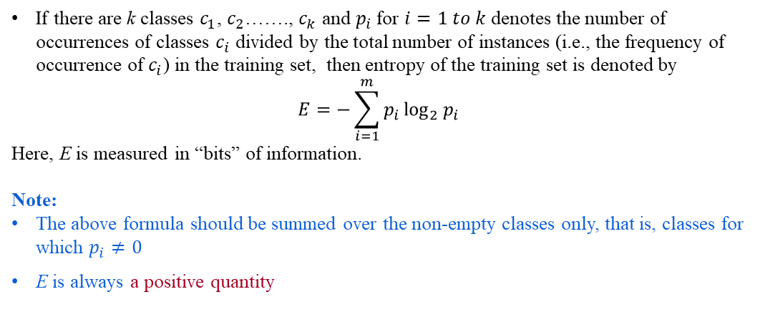
Entropy of a Training Set
If there are k classes $c_{1}$, $c_{2}$……., $c_{k}$ and $p_{i}$for $i=1 to k$ denotes the number of occurrences of classes $c_{i}$ divided by the total number of instances (i.e., the frequency of occurrence of $c_{i}$) in the training set, then entropy of the training set is denoted by
$$E=−\sum_{i=1}^{m}{p_{i}}\log_{2}{p_{i}}$$
Here, E is measured in “bits” of information.
Note:
The above formula should be summed over the non-empty classes only, that is, classes for which $p_{i}≠0$
E is always a positive quantity

Slide 11
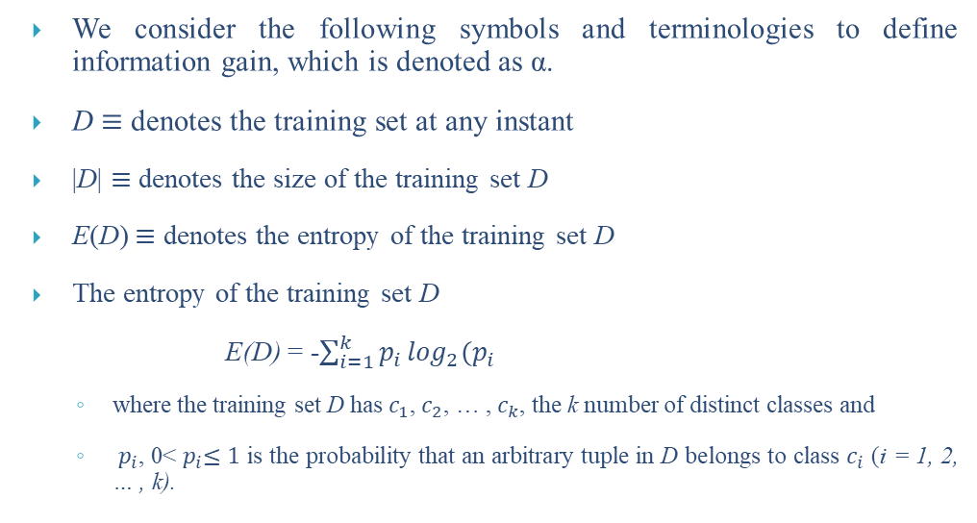
Defining Information Gain
We consider the following symbols and terminologies to define information gain, which is denoted as α.
D$≡$ denotes the training set at any instant
|D|$≡$ denotes the size of the training set D
E(D)$≡$ denotes the entropy of the training set D
The entropy of the training set D
E(D) = -$\sum_{i=1}^{k}{p_{i}}\log_{2}(p_{i}$
where the training set D has $c_{1}$, $c_{2}$, … , $c_{k}$, the k number of distinct classes and
$p_{i}$, 0<${ p}_{i}≤1$ is the probability that an arbitrary tuple in D belongs to class $c_{i}$ (i = 1, 2, … , k).

Slide 12
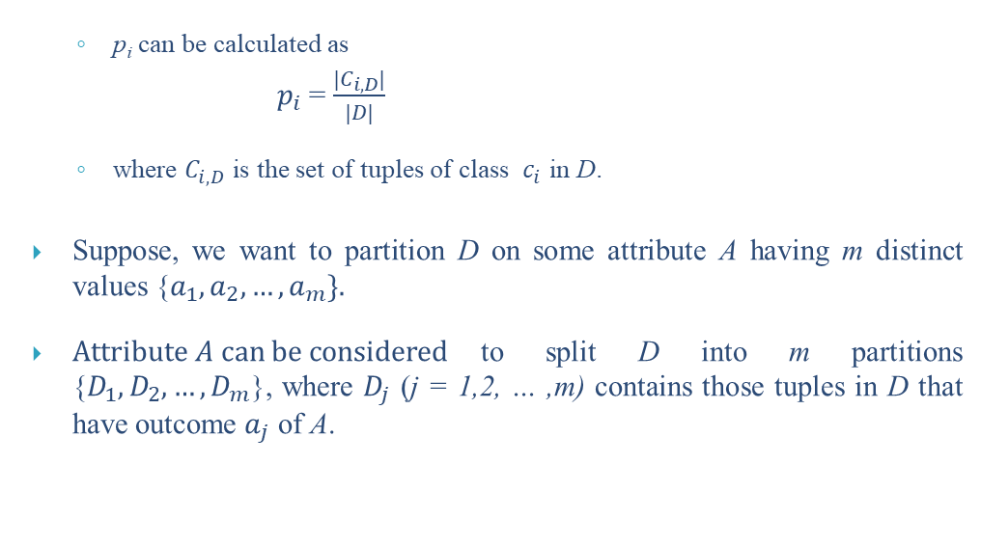
Defining Information Gain
p_{i}can be calculated as
$p_{i}$ = $\frac{{|C}_{i,D}|}{|D|}$
where $C_{i,D}$ is the set of tuples of class ${ c}_{i}$ in D.
Suppose, we want to partition D on some attribute A having m distinct values {$a_{1},a_{2}, …,a_{m}\}.$
$Attribute A can be considered$to split D into m partitions {$D_{1},D_{2}, …,D_{m}$}, where $D_{j}$ (j = 1,2, … ,m) contains those tuples in D that have outcome $a_{j}$ of A.

Slide 13
Entropy of a Training Set
OPTH dataset
Consider the OTPH data shown in the following table with total 24 instances in it.
Age | Eye sight | Astigmatic | Use Type | Class
1 1 1 1 1 1 | 1 1 1 1 2 2 | 1 1 2 2 1 1 | 1 2 1 2 1 2 | 3 2 3 1 3 2
1 1 2 2 2 2 | 2 2 1 1 1 1 | 2 2 1 1 2 2 | 1 2 1 2 1 2 | 3 1 3 2 3 1
2 2 2 2 3 3 | 2 2 2 2 1 1 | 1 1 2 2 1 1 | 1 2 1 2 1 2 | 3 2 3 3 3 3
3 3 3 3 3 3 | 1 1 2 2 2 2 | 2 2 1 1 2 2 | 1 2 1 2 1 2 | 3 1 3 2 3 3
A coded forms for all values of attributes are used to avoid the cluttering in the table.

Slide 14
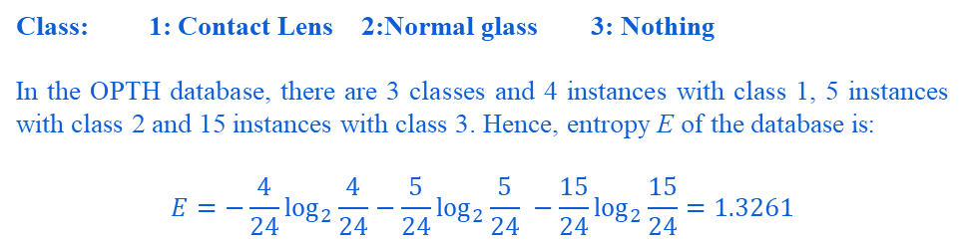
Entropy of a training set
Specification of the attributes are as follows.
Age | Eye Sight | Astigmatic | Use Type
1: Young | 1: Myopia | 1: No | 1: Frequent
2: Middle-aged | 2: Hypermetropia | 2: Yes | 2: Less
3: Old
Class: 1: Contact Lens 2:Normal glass 3: Nothing
In the OPTH database, there are 3 classes and 4 instances with class 1, 5 instances with class 2 and 15 instances with class 3. Hence, entropy E of the database is:
$$E=−\frac{4}{24}\log_{2}{\frac{4}{24}}−\frac{5}{24}\log_{2}{\frac{5}{24}} −\frac{15}{24}\log_{2}{\frac{15}{24}=1.3261}$$

Slide 15
Note:
The entropy of a training set implies the number of yes/no questions, on the average, needed to determine an unknown test to be classified.
It is very crucial to decide the series of questions about the value of a set of attribute, which collectively determine the classification. Sometimes it may take one question, sometimes many more.
Decision tree induction helps us to ask such a series of questions. In other words, we can utilize entropy concept to build a better decision tree.
How entropy can be used to build a decision tree is our next topic of discussion.

Slide 16
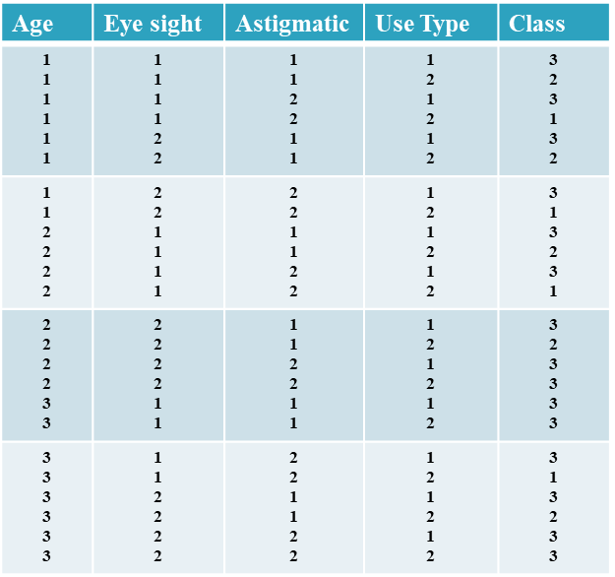
Calculation of α using Frequency Table
OTPH Dataset
With reference to OPTH dataset, and for the attribute Age, the frequency table would look like
 | Age=1 | Age=2 | Age=3 | Row Sum
Class 1 | 2 | 1 | 1 | 4
Class 2 | 2 | 2 | 1 | 5
Class 3 | 4 | 5 | 6 | 15
Column Sum | 8 | 8 | 8 | 24
N=24

Slide 17
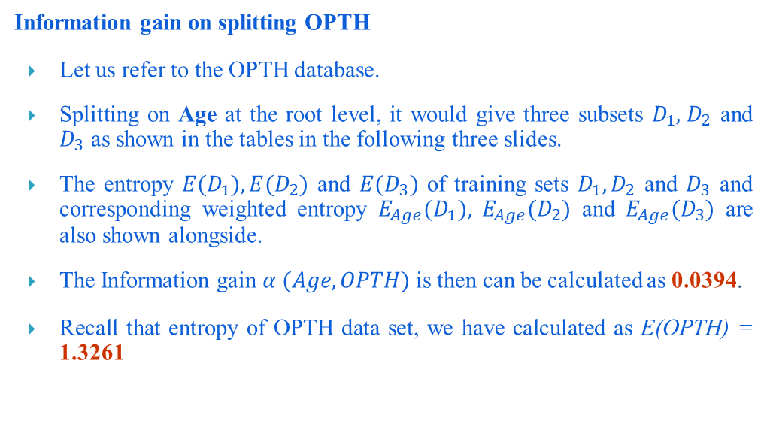
Information Gain Calculation
Information gain on splitting OPTH
Let us refer to the OPTH database.
Splitting on Age at the root level, it would give three subsets $D_{1},{ D}_{2}$ and $D_{3}$ as shown in the tables in the following three slides.
The entropy ${E(D}_{1}),{E(D}_{2})$ and ${E(D}_{3})$ of training sets $D_{1},D_{2}$ and $D_{3}$ and corresponding weighted entropy $E_{Age}{(D}_{1}),$$E_{Age}{(D}_{2})$ and $E_{Age}{(D}_{3})$ are also shown alongside.
The Information gain $α (Age, OPTH)$ is then can be calculated as 0.0394.
Recall that entropy of OPTH data set, we have calculated as E(OPTH) = 1.3261

Slide 18


Information Gain Calculation
Information gain on splitting OPTH
Training set: $D_{1}$(Age = 1)
Age | Eye-sight | Astigmatism | Use type | Class
1 | 1 | 1 | 1 | 3
1 | 1 | 1 | 2 | 2
1 | 1 | 2 | 1 | 3
1 | 1 | 2 | 2 | 1
1 | 2 | 1 | 1 | 3
1 | 2 | 1 | 2 | 2
1 | 2 | 2 | 1 | 3
1 | 2 | 2 | 2 | 1
${E(D}_{1})=−\frac{2}{8}\log_{2}$($\frac{2}{8}$) $−\frac{2}{8}\log_{2}$($\frac{2}{8}$)
$−$$\frac{4}{8}\log_{2}$($\frac{4}{8}$) = 1.5
$E_{Age}{(D}_{1})=$$\frac{8}{24}$× 1.5 = 0.5000

Slide 19
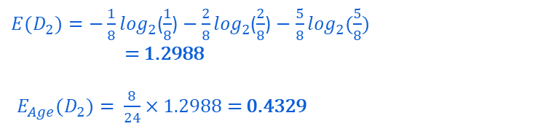
Calculating Information Gain
Training set: $D_{2}$(Age = 2)
Age | Eye-sight | Astigmatism | Use type | Class
2 | 1 | 1 | 1 | 3
2 | 1 | 1 | 2 | 2
2 | 1 | 2 | 1 | 3
2 | 1 | 2 | 2 | 1
2 | 2 | 1 | 1 | 3
2 | 2 | 1 | 2 | 2
2 | 2 | 2 | 1 | 3
2 | 2 | 2 | 2 | 3
${E(D}_{2})=−\frac{1}{8}\log_{2}$($\frac{1}{8}$) $−\frac{2}{8}\log_{2}$($\frac{2}{8}$) $−$$\frac{5}{8}\log_{2}$($\frac{5}{8}$)
= 1.2988
$E_{Age}{(D}_{2})=$$\frac{8}{24}$× 1.2988 = 0.4329

Slide 20

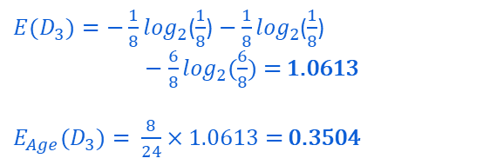
Calculating Information Gain
Training set: $D_{3}$(Age = 3)
Age | Eye-sight | Astigmatism | Use type | Class
3 | 1 | 1 | 1 | 3
3 | 1 | 1 | 2 | 3
3 | 1 | 2 | 1 | 3
3 | 1 | 2 | 2 | 1
3 | 2 | 1 | 1 | 3
3 | 2 | 1 | 2 | 2
3 | 2 | 2 | 1 | 3
3 | 2 | 2 | 2 | 3
${E(D}_{3})=−\frac{1}{8}\log_{2}$($\frac{1}{8}$) $−\frac{1}{8}\log_{2}$($\frac{1}{8}$)
$−$$\frac{6}{8}\log_{2}$($\frac{6}{8}$) = 1.0613
$E_{Age}{(D}_{3})=$$\frac{8}{24}$× 1.0613 = 0.3504
$α (Age, D)$ = 1.3261 – (0.5000 + 0.4329 + 0.3504) = 0.0394

Slide 21
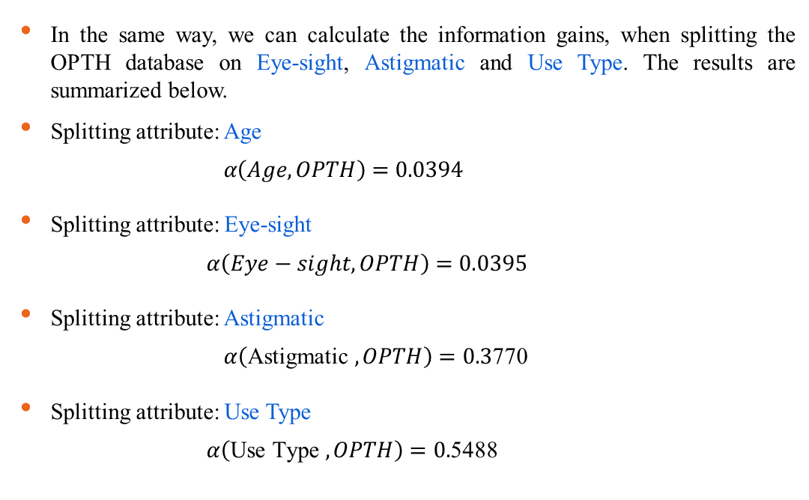
Information Gains for Different Attributes
In the same way, we can calculate the information gains, when splitting the OPTH database on Eye-sight, Astigmatic and Use Type. The results are summarized below.
Splitting attribute: Age
$$α\left(Age, OPTH\right)=0.0394$$
Splitting attribute: Eye-sight
$α\left(Eye−sight, OPTH\right)=0.0395$
Splitting attribute: Astigmatic
$α\left(\text{Astigmatic} , OPTH\right)=0.3$770
Splitting attribute: Use Type
$α\left(\text{Use} \text{Type} , OPTH\right)=0.$5488

Slide 22
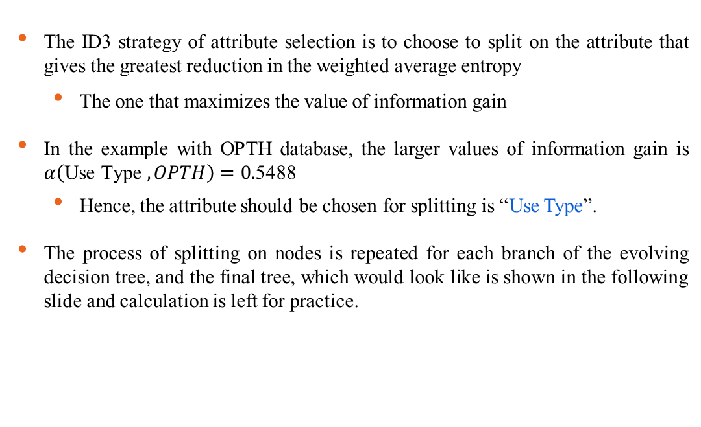
Decision Tree Induction : ID3 Way
The ID3 strategy of attribute selection is to choose to split on the attribute that gives the greatest reduction in the weighted average entropy
The one that maximizes the value of information gain
In the example with OPTH database, the larger values of information gain is $α\left(\text{Use} \text{Type} , OPTH\right)=0.$5488
Hence, the attribute should be chosen for splitting is “Use Type”.
The process of splitting on nodes is repeated for each branch of the evolving decision tree, and the final tree, which would look like is shown in the following slide and calculation is left for practice.

Slide 23















Decision Tree Induction : ID3 Way
$$E\left(OPTH\right)=1.3261$$
$$OPTH$$
$$×$$
$$×$$
✓
$$×$$
Age
Eye-sight
Use Type
Astigmatic
$$α=0.0394$$
$$α=0.395$$
$$α=0.0394$$
$$α=0.3770$$
$$D1$$
$$Frequent(1)$$
$$D2$$
$$Less(2)$$
Age | Eye | Ast | Use | Class
1 | 1 | 1 | 1 | 3
1 | 1 | 2 | 1 | 3
1 | 2 | 1 | 1 | 3
1 | 2 | 2 | 1 | 3
2 | 1 | 1 | 1 | 3
2 | 2 | 1 | 1 | 3
2 | 2 | 2 | 1 | 3
3 | 1 | 1 | 1 | 3
3 | 1 | 2 | 1 | 3
3 | 2 | 1 | 1 | 3
3 | 2 | 2 | 1 | 3
Age | Eye | Ast | Use | Class
1 | 1 | 1 | 2 | 2
1 | 1 | 2 | 2 | 1
1 | 2 | 1 | 2 | 2
1 | 2 | 2 | 2 | 1
2 | 1 | 1 | 2 | 2
2 | 1 | 2 | 2 | 1
2 | 2 | 1 | 2 | 2
3 | 1 | 1 | 2 | 3
3 | 1 | 2 | 2 | 3
3 | 2 | 1 | 2 | 2
3 | 2 | 2 | 2 | 3
$${E(D}_{1})=?$$
$${E(D}_{2})=?$$
$$?$$
$$?$$
$$?$$
Age
Eye-sight
Astigmatic
$$α=?$$
$$α=?$$
$$α=?$$

Slide 24
Decision Tree Classifier
Stopping Criteria for Decision Tree Algorithm
Stop expanding a node when all the records belong to the same class.
Stop expanding a node when all the records have similar attribute values.
Early termination.

Slide 25
Performance Evaluation Metrics
Classification models must be evaluated to determine their degree of effectiveness for performing a specific task. While good classification models are useful for prediction purposes, poor classification models lead to unreliable outcomes, and thus, are not useful for the user.
Performance evaluation metrics are based on the total number of the following variables:
True Positives: outcome correctly predicted as positive class
True Negatives: outcome correctly predicted as negative class
False Positives: outcome incorrectly predicted as positive class
False Negatives: outcome incorrectly predicted as negative class

Slide 26
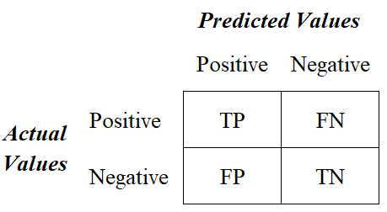
Confusion Matrix

Slide 27
performance metrics
There are four main performance metrics used to evaluate the effectiveness of classification models:
Accuracy: test’s ability to correctly predict both classes
Precision: test’s ability to correctly detect positive classes from all predicted positive classes
Recall (Sensitivity): test’s ability to correctly detect positive classes from all actual positive classes
F1 Score: harmonic mean of precision and recall

Slide 28
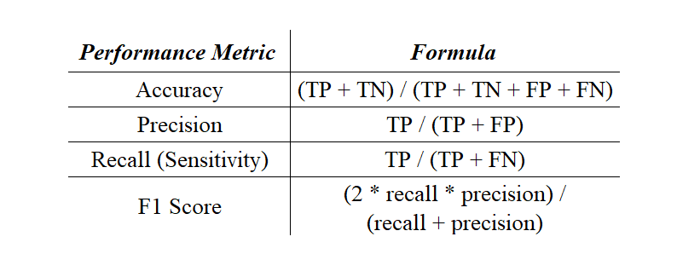

Slide 29
classification report
A classification report is a performance evaluation metric in machine learning.
It is used to show the precision, recall, F1 Score, and support of your trained classification model.
It provides a better understanding of the overall performance of our trained model.

Slide 30
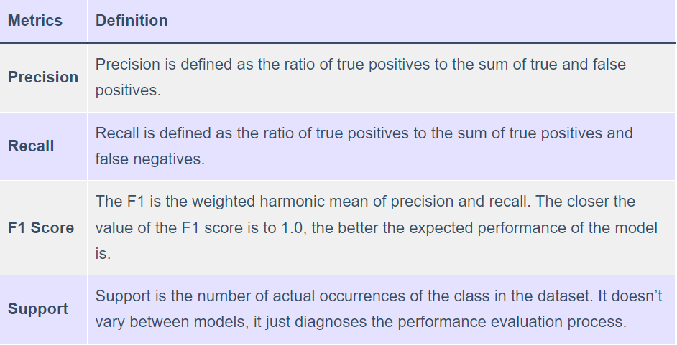

Slide 31
Pros
Decision trees are easy to interpret and visualize.
It can easily capture Non-linear patterns.
It requires fewer data preprocessing from the user, for example, there is no need to normalize columns.
It can be used for feature engineering such as predicting missing values, suitable for variable selection.
The decision tree has no assumptions about distribution because of the non-parametric nature of the algorithm.

Slide 32
Cons
Sensitive to noisy data. It can overfit noisy data.
The small variation(or variance) in data can result in the different decision tree.
This can be reduced by bagging and boosting algorithms.
Decision trees are biased with imbalance dataset, so it is recommended that balance out the dataset before creating the decision tree.

Slide 33
Thank You

